Slide 1
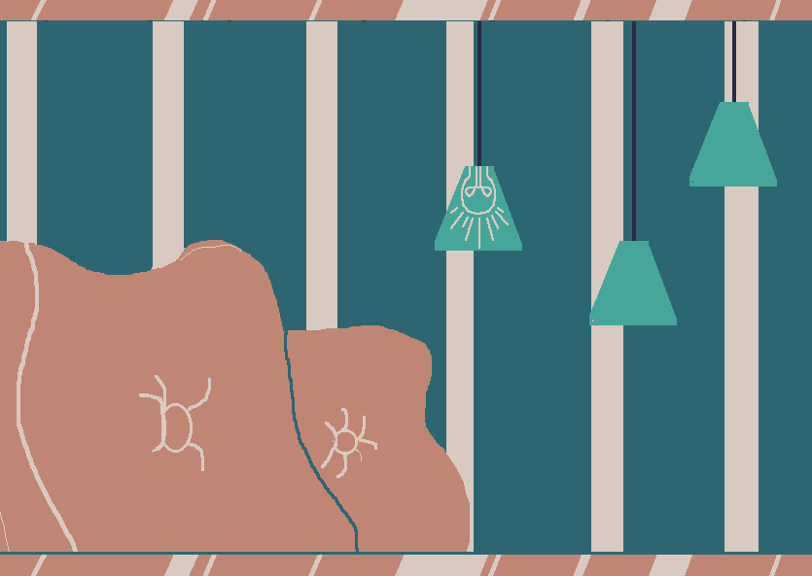
Pong
Team 7

Slide 2
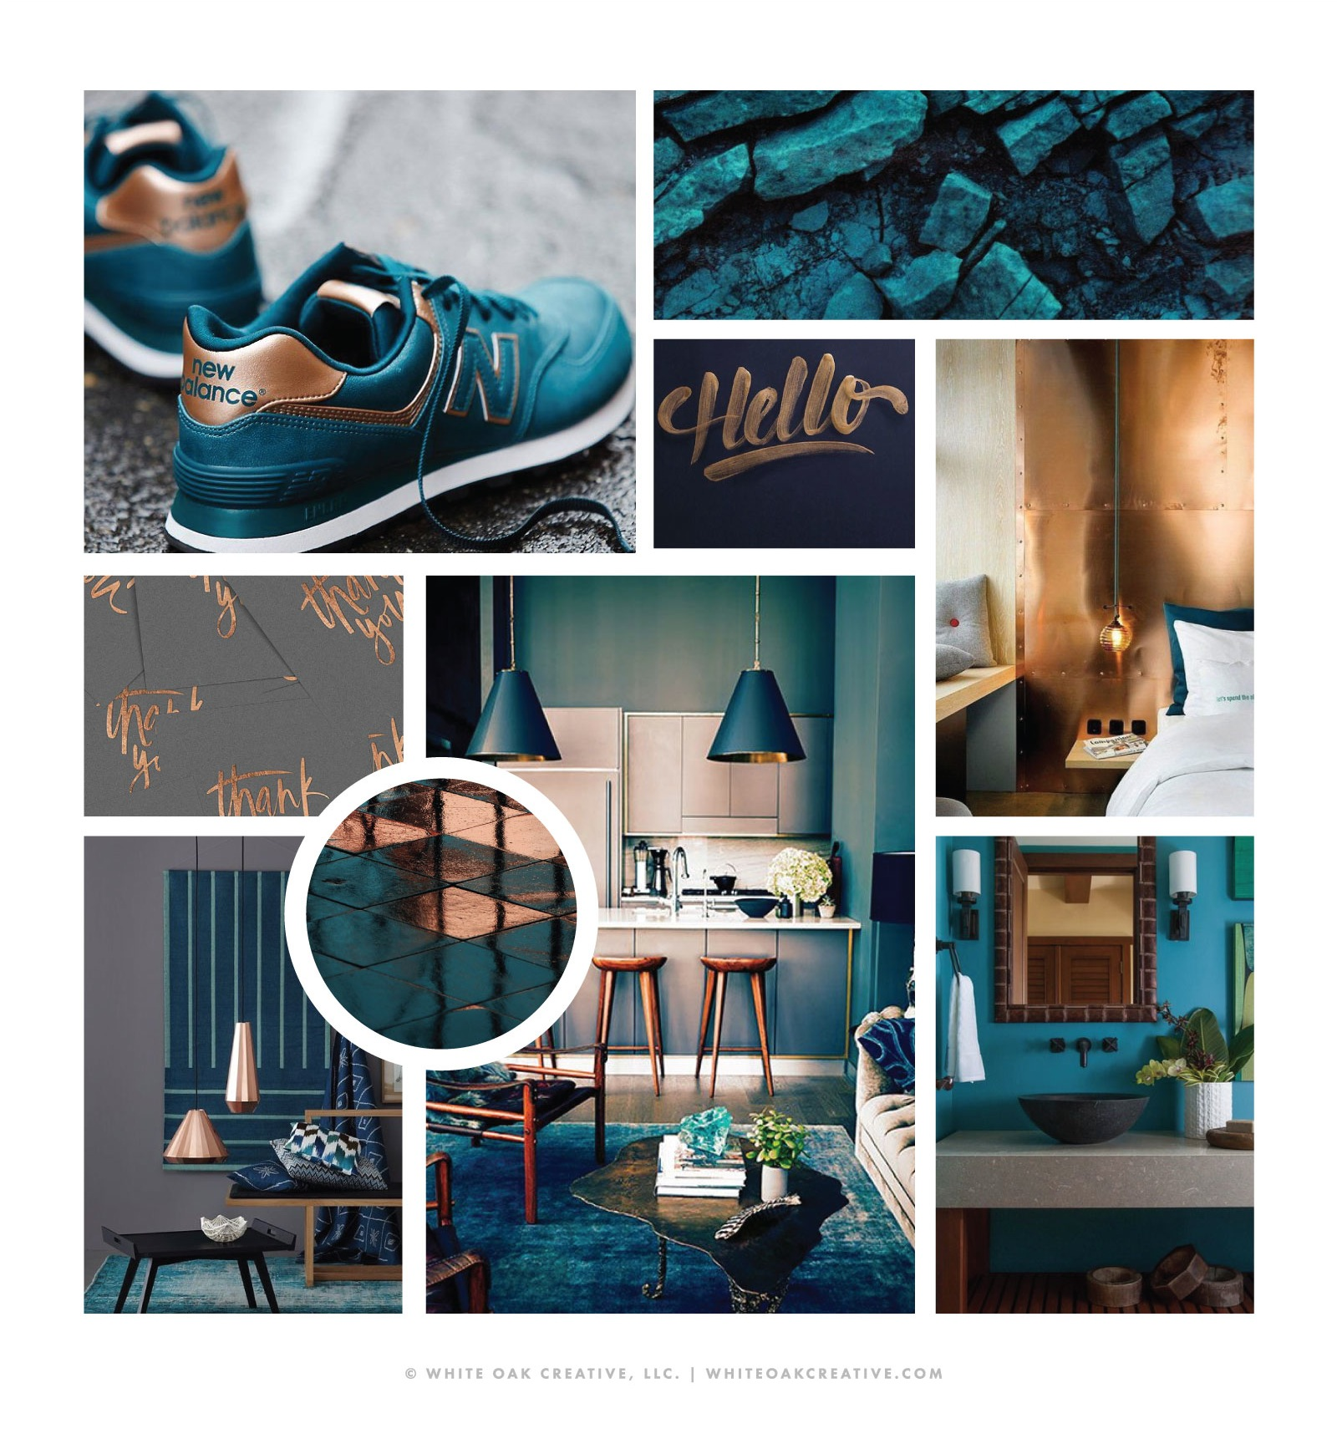
Research board
(Color Scheme Distilled From Mood Board via Adobe Colors)

Slide 3
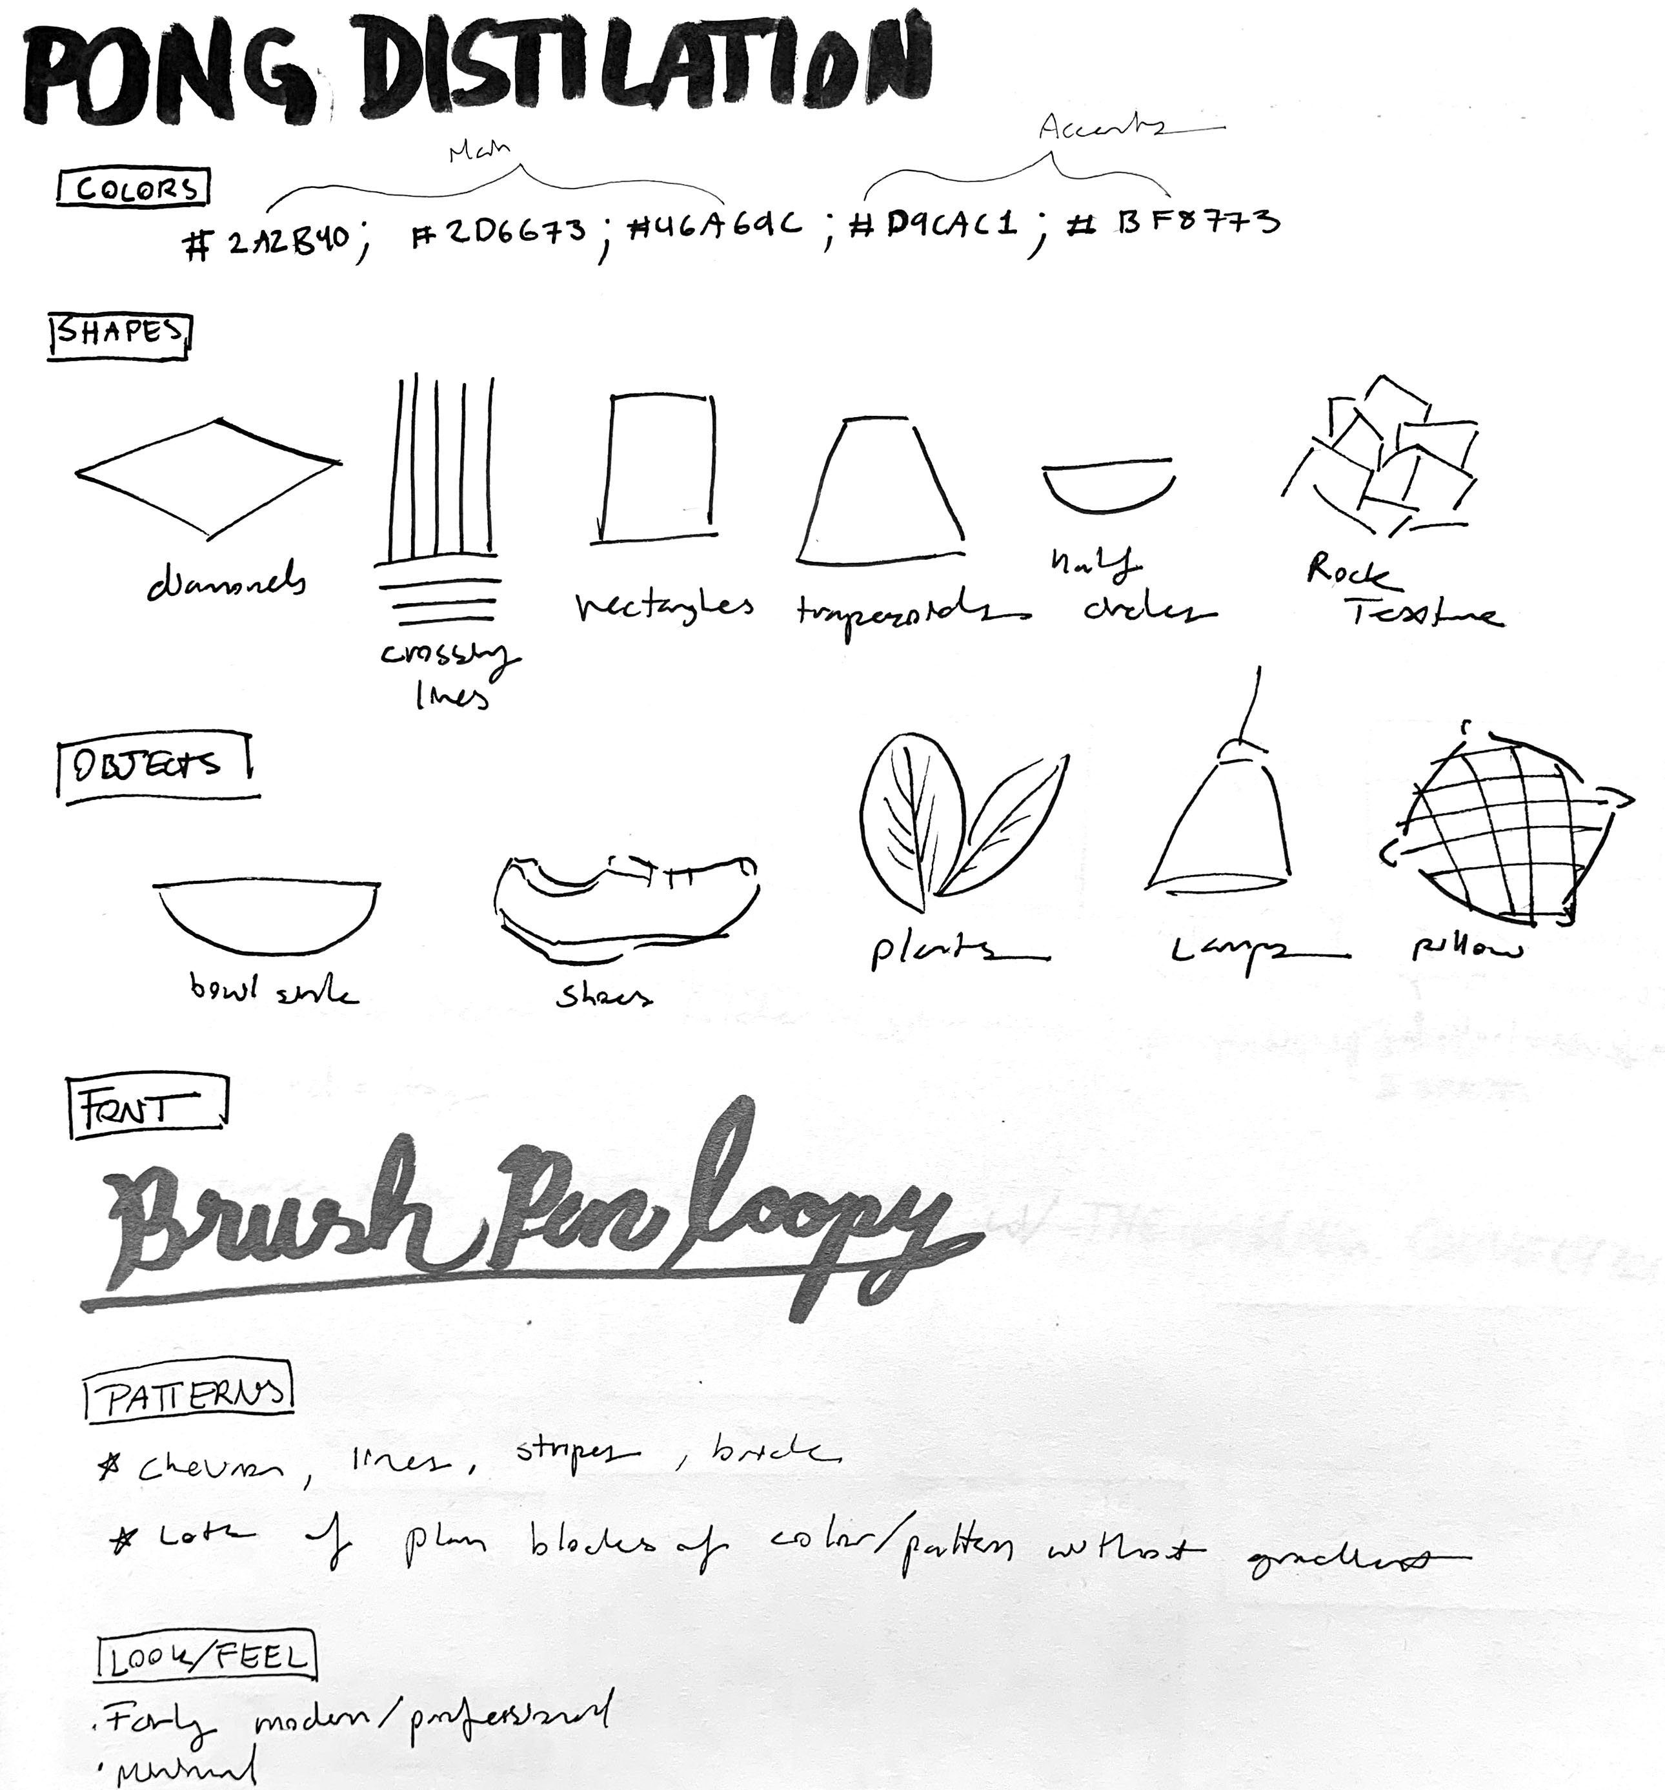
Distillation
(Distilled Colors, Shapes, Objects, Fonts, Patterns, & Look and Feel from Mood Board)

Slide 4
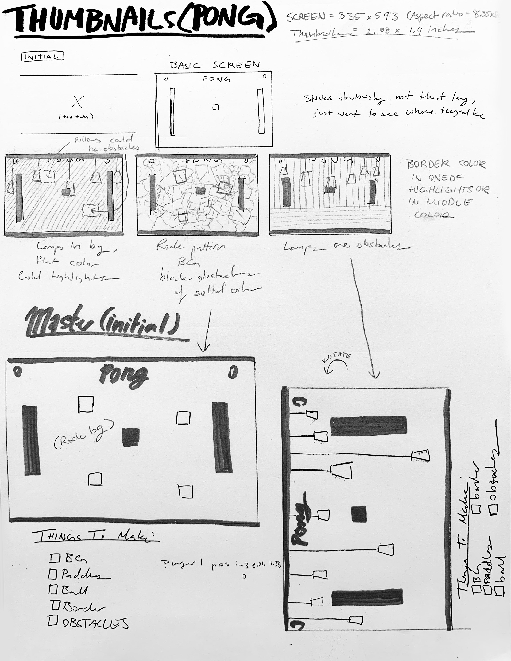
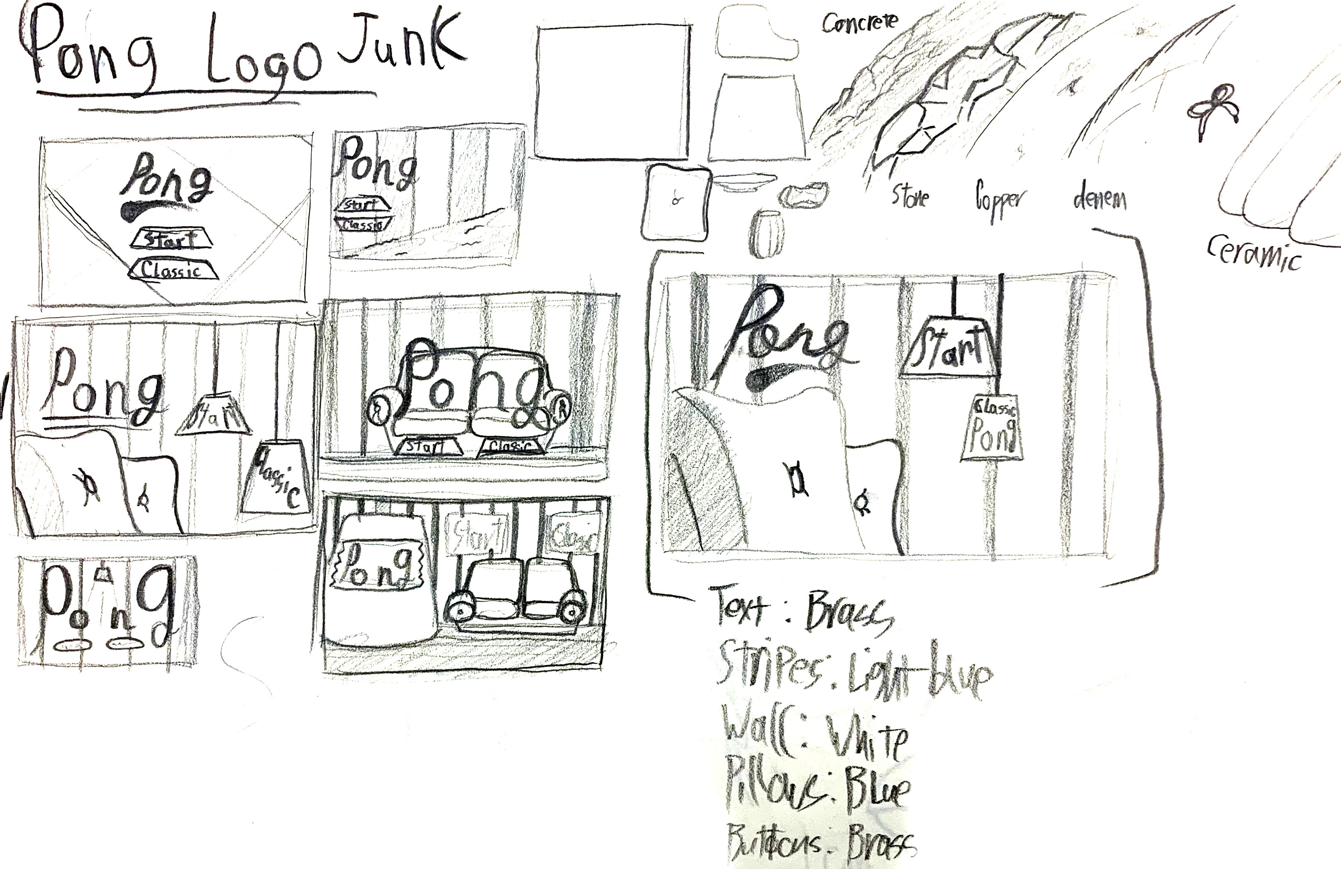
Thumbnails
(Took Distilled Info and made thumbnails for the start screen, win screens, and game screen)

Slide 5


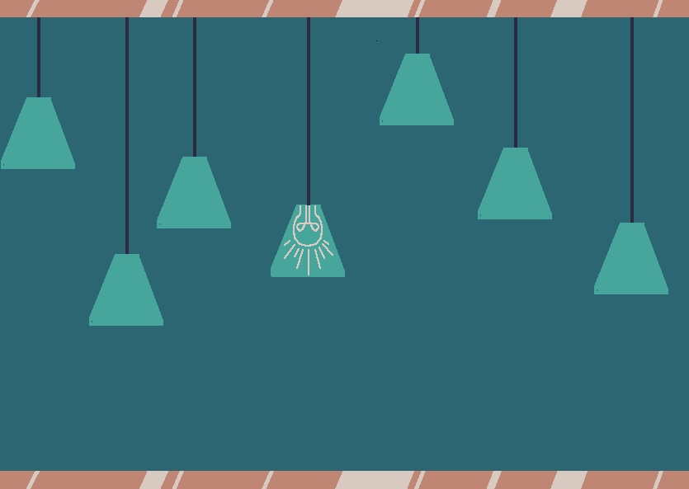

Final art

Slide 6



Final art
(Paddle, ball, buttons, and border all made to be like the rose gold from the original image)

Slide 7
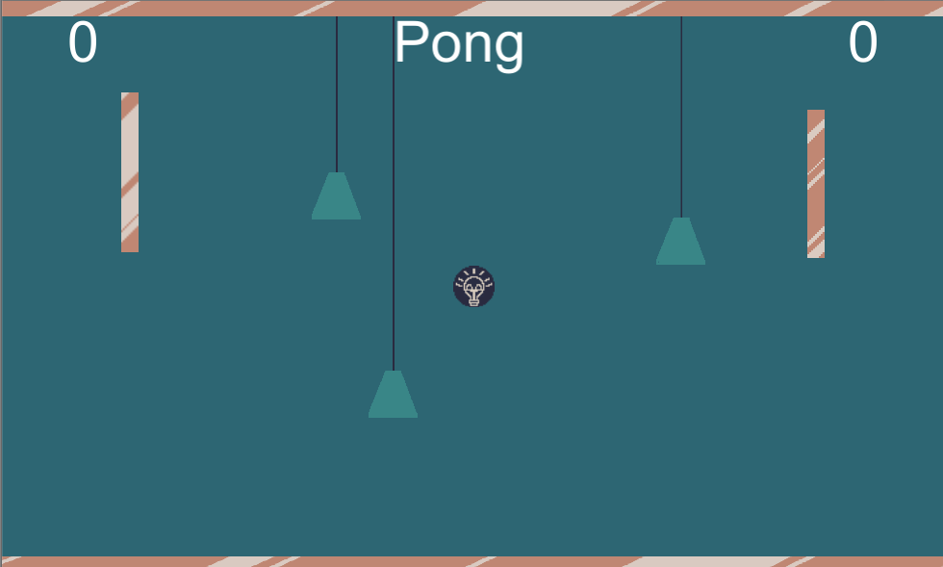
Screenshot of the game

